Slide 1
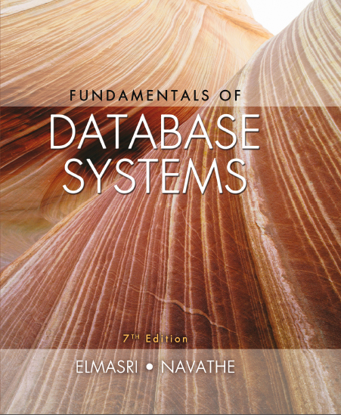
Fundamentals of Database Systems
Seventh Edition
Chapter 6
Basic S Q L
Copyright © 2016, 2011, 2007 Pearson Education, Inc. All Rights Reserved
Notes:
If this PowerPoint presentation contains mathematical equations, you may need to check that your computer has the following installed:
1) MathType Plugin
2) Math Player (free versions available)
3) NVDA Reader (free versions available)

Slide 2
Learning Objectives
6.1 S Q L Data Definition and Data Types
6.2 Specifying Constraints in S Q L
6.3 Basic Retrieval Queries in S Q L
6.4 INSERT, DELETE, and UPDATE Statements in S Q L
6.5 Additional Features of S Q L

Slide 3
Basic S Q L
S Q L language
Considered one of the major reasons for the commercial success of relational databases
S Q L
The origin of S Q L is relational predicate calculus called tuple calculus (see Chapter 8) which was proposed initially as the language SQUARE.
S Q L Actually comes from the word “SEQUEL” which was the original term used in the paper: “SEQUEL TO SQUARE” by Chamberlin and Boyce. I B M could not copyright that term, so they abbreviated to S Q L and copyrighted the term S Q L.
Now popularly known as “Structured Query language”.
S Q L is an informal or practical rendering of the relational data model with syntax

Slide 4
S Q L Data Definition, Data Types, Standards
Terminology:
Table, row, and column used for relational model terms relation, tuple, and attribute
CREATE statement
Main S Q L command for data definition
The language has features for: Data definition, Data Manipulation, Transaction control (Transact-S Q L, Chapter 20), Indexing (Chapter 17), Security specification (Grant and Revoke- see Chapter 30), Active databases (Chapter 26), Multi-media (Chapter 26), Distributed databases (Chapter 23) etc.

Slide 5
S Q L Standards
S Q L has gone through many standards: starting with S Q L-86 or S Q L 1.A. S Q L-92 is referred to as S Q L-2.
Later standards (from S Q L-1999) are divided into core specification and specialized extensions. The extensions are implemented for different applications – such as data mining, data warehousing, multimedia etc.
S Q L-2006 added X M L features (Chapter 13); In 2008 they added Object-oriented features (Chapter 12).
S Q L-3 is the current standard which started with S Q L-1999. It is not fully implemented in any R D B M S.

Slide 6
Schema and Catalog Concepts in S Q L (1 of 2)
We cover the basic standard S Q L syntax – there are variations in existing R D B M S systems
S Q L schema
Identified by a schema name
Includes an authorization identifier and descriptors for each element
Schema elements include
Tables, constraints, views, domains, and other constructs
Each statement in S Q L ends with a semicolon

Slide 7
Schema and Catalog Concepts in S Q L (2 of 2)
CREATE SCHEMA statement
CREATE SCHEMA COMPANY AUTHORIZATION ‘Jsmith’;
Catalog
Named collection of schemas in an S Q L environment
S Q L also has the concept of a cluster of catalogs.

Slide 8
The CREATE TABLE Command in S Q L (1 of 3)
Specifying a new relation
Provide name of table
Specify attributes, their types and initial constraints
Can optionally specify schema:
CREATE TABLE COMPANY.EMPLOYEE ...
or
CREATE TABLE EMPLOYEE ...

Slide 9
The CREATE TABLE Command in S Q L (2 of 3)
Base tables (base relations)
Relation and its tuples are actually created and stored as a file by the D B M S
Virtual relations (views)
Created through the CREATE VIEW statement. Do not correspond to any physical file.

Slide 10
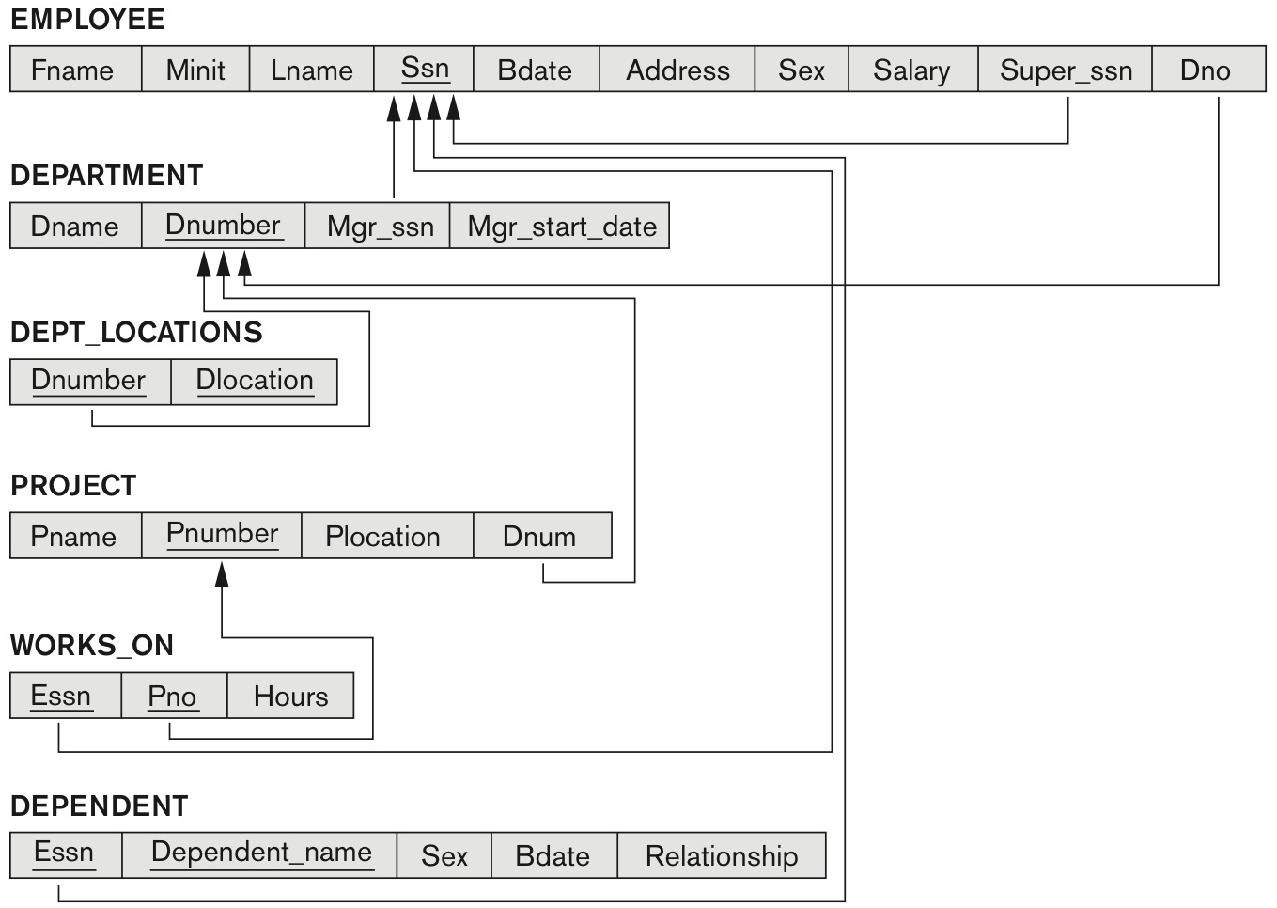
COMPANY Relational Database Schema
Figure 5.7 Referential integrity constraints displayed on the COMPANY relational database schema.

Slide 11
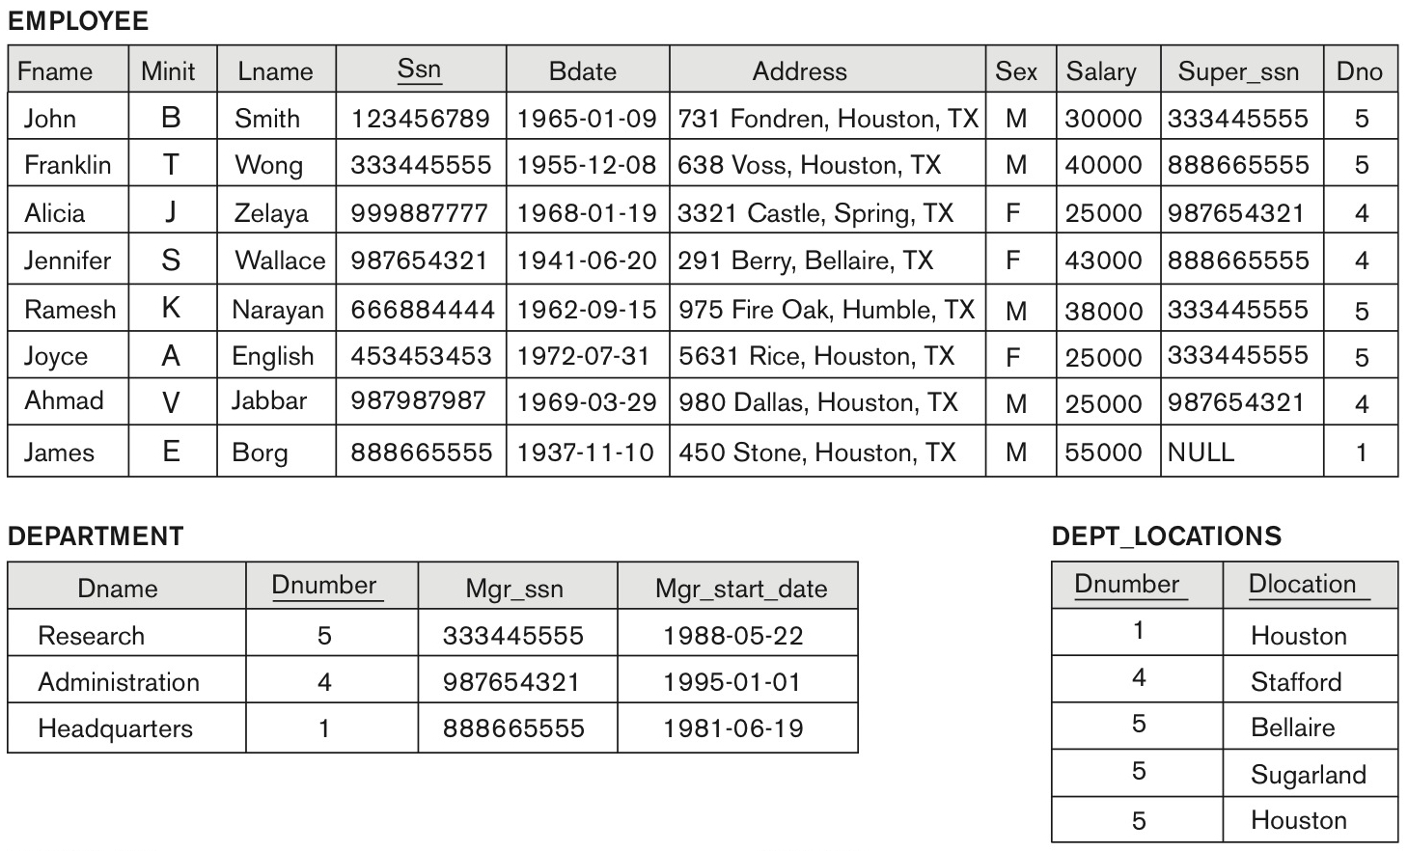
Figure 5.6 One Possible Database State for the COMPANY Relational Database Schema (1 of 2)

Slide 12
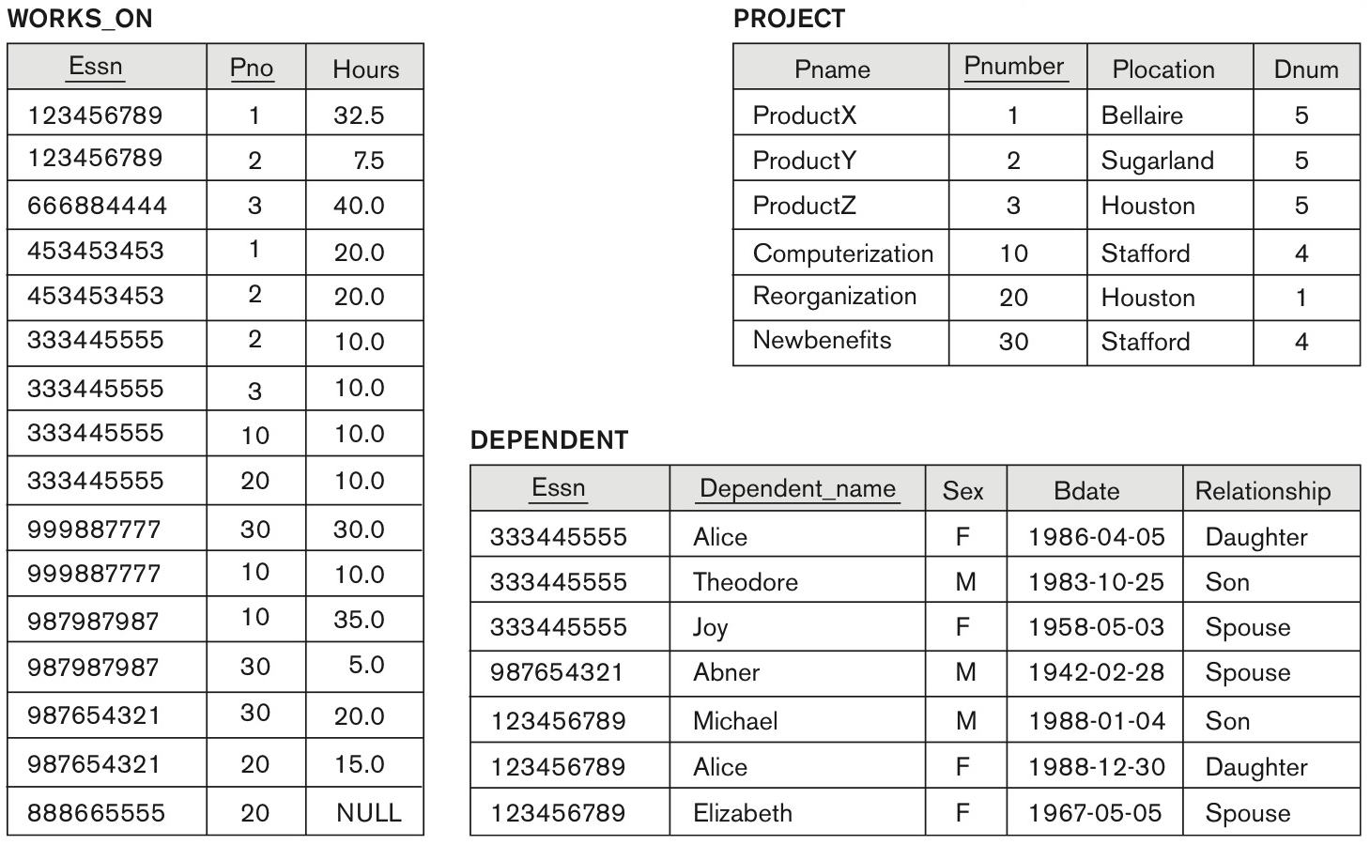
Figure 5.6 One Possible Database State for the COMPANY Relational Database Schema (2 of 2)

Slide 13
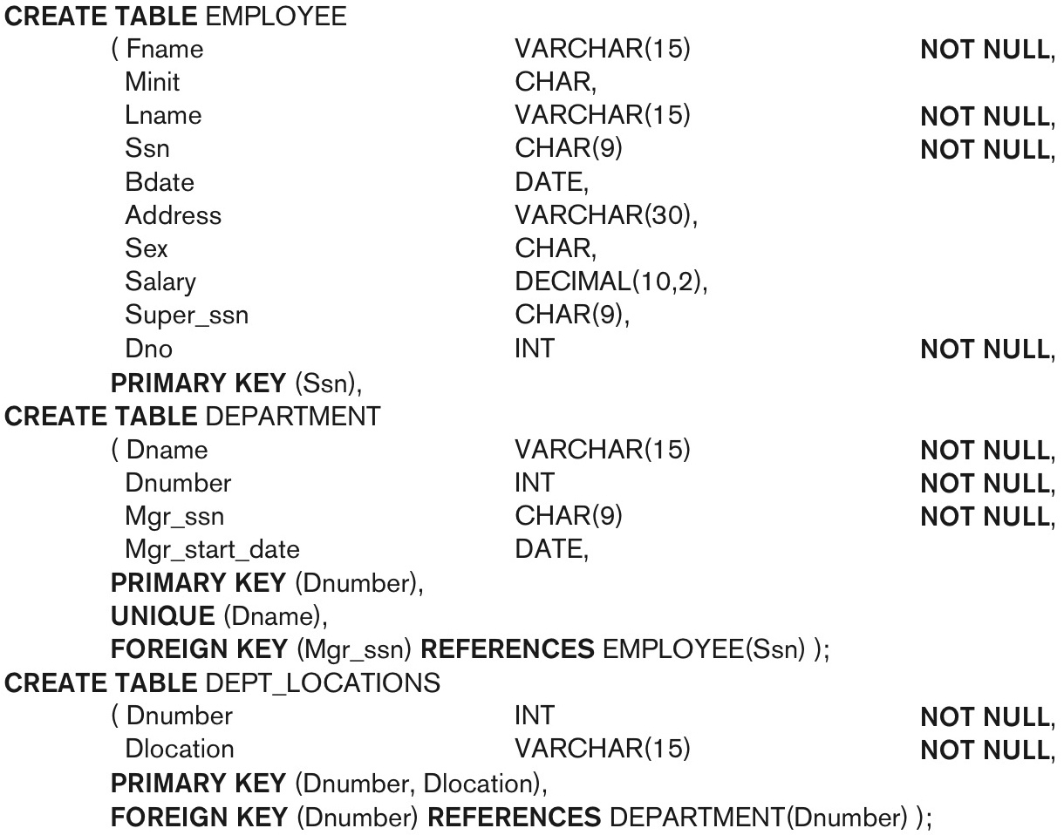
Figure 6.1 S Q L CREATE TABLE Data Definition Statements for Defining the Company Schema from Figure 5.7 (1 of 2)

Slide 14
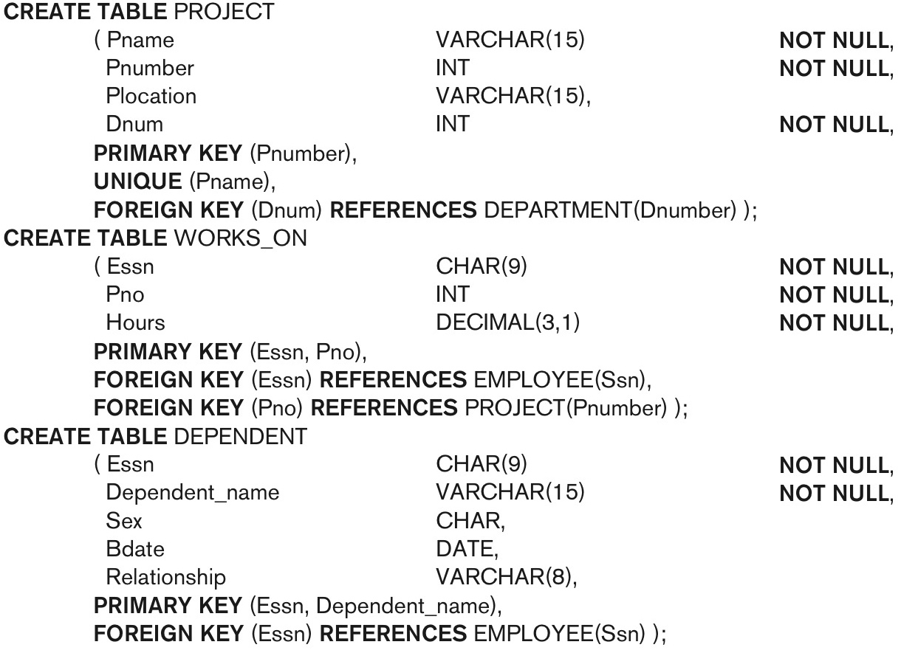
Figure 6.1 S Q L CREATE TABLE Data Definition Statements for Defining the Company Schema from Figure 5.7 (2 of 2)

Slide 15
The CREATE TABLE Command in S Q L (3 of 3)
Some foreign keys may cause errors
Specified either via:
Circular references
Or because they refer to a table that has not yet been created
D B A’s have ways to stop referential integrity enforcement to get around this problem.

Slide 16
Attribute Data Types and Domains in S Q L (1 of 4)
Basic data types
Numeric data types
Integer numbers: INTEGER, INT, and SMALLINT
Floating-point (real) numbers: FLOAT or REAL, and DOUBLE PRECISION
Character-string data types
Fixed length: CHAR(n), CHARACTER(n)
Varying length: VARCHAR(n), CHAR VARYING(n), CHARACTER VARYING(n)

Slide 17
Attribute Data Types and Domains in S Q L (2 of 4)
Bit-string data types
Fixed length: BIT(n)
Varying length: BIT VARYING(n)
Boolean data type
Values of TRUE or FALSE or NULL
DATE data type
Ten positions
Components are YEAR, MONTH, and DAY in the form Y Y Y Y-M M-D D
Multiple mapping functions available in R D B M S s to change date formats

Slide 18
Attribute Data Types and Domains in S Q L (3 of 4)
Additional data types
Timestamp data type
Includes the DATE and TIME fields
Plus a minimum of six positions for decimal fractions of seconds
Optional WITH TIME ZONE qualifier
INTERVAL data type
Specifies a relative value that can be used to increment or decrement an absolute value of a date, time, or timestamp
DATE, TIME, Timestamp, INTERVAL data types can be cast or converted to string formats for comparison.

Slide 19
Attribute Data Types and Domains in S Q L (4 of 4)
Domain
Name used with the attribute specification
Makes it easier to change the data type for a domain that is used by numerous attributes
Improves schema readability
Example:
CREATE DOMAIN S S N_TYPE AS CHAR(9);
TYPE
User Defined Types (U D T s) are supported for object-oriented applications. (See Chapter 12) Uses the command: CREATE TYPE

Slide 20
Specifying Constraints in S Q L
Basic constraints:
Relational Model has 3 basic constraint types that are supported in S Q L:
Key constraint: A primary key value cannot be duplicated
Entity Integrity Constraint: A primary key value cannot be null
Referential integrity constraints: The “foreign key “ must have a value that is already present as a primary key, or may be null.

Slide 21
Specifying Attribute Constraints
Other Restrictions on attribute domains:
Default value of an attribute
DEFAULT <value>
NULL is not permitted for a particular attribute (NOT NULL)
CHECK clause
Dnumber INT NOT NULL CHECK (Dnumber > 0 AND Dnumber < 21);

Slide 22
Specifying Key and Referential Integrity Constraints (1 of 2)
PRIMARY KEY clause
Specifies one or more attributes that make up the primary key of a relation
Dnumber INT PRIMARY KEY;
UNIQUE clause
Specifies alternate (secondary) keys (called CANDIDATE keys in the relational model).
Dname VARCHAR(15) UNIQUE;

Slide 23
Specifying Key and Referential Integrity Constraints (2 of 2)
FOREIGN KEY clause
Default operation: reject update on violation
Attach referential triggered action clause
Options include SET NULL, CASCADE, and SET DEFAULT
Action taken by the D B M S for SET NULL or SET DEFAULT is the same for both ON DELETE and ON UPDATE
CASCADE option suitable for “relationship” relations

Slide 24
Giving Names to Constraints
Using the Keyword CONSTRAINT
Name a constraint
Useful for later altering

Slide 25
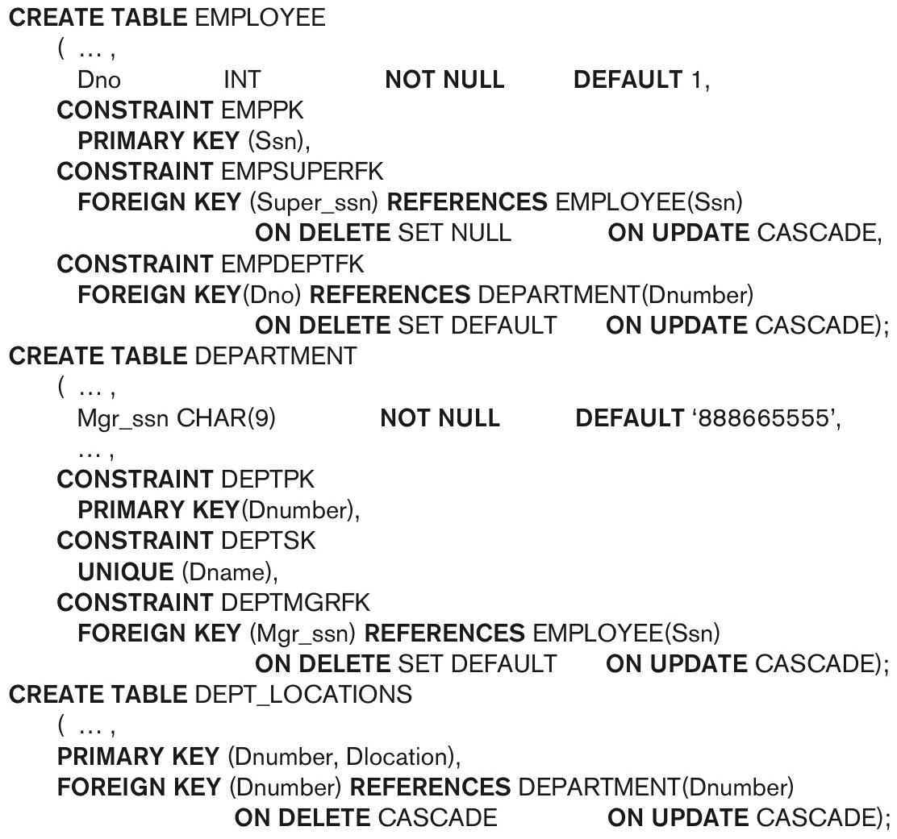
Figure 6.2 Default Attribute Values and Referential Integrity Triggered Action Specification

Slide 26
Specifying Constraints on Tuples Using CHECK
Additional Constraints on individual tuples within a relation are also possible using CHECK
CHECK clauses at the end of a CREATE TABLE statement
Apply to each tuple individually
CHECK (Dept_create_date <= Mgr_start_date);

Slide 27
Basic Retrieval Queries in S Q L
SELECT statement
One basic statement for retrieving information from a database
S Q L allows a table to have two or more tuples that are identical in all their attribute values
Unlike relational model (relational model is strictly set-theory based)
Multiset or bag behavior
Tuple-id may be used as a key

Slide 28
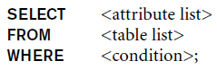
The SELECT-FROM-WHERE Structure of Basic S Q L Queries (1 of 2)
Basic form of the SELECT statement:
where
<attribute list> is a list of attribute names whose values are to be retrieved by the query.
<table list> is a list of the relation names required to process the query.
<condition> is a conditional (Boolean) expression that identifies the tuples to be retrieved by the query.

Slide 29
The SELECT-FROM-WHERE Structure of Basic S Q L Queries (2 of 2)
Logical comparison operators
Projection attributes
Attributes whose values are to be retrieved
Selection condition
Boolean condition that must be true for any retrieved tuple. Selection conditions include join conditions (see Chapter 8) when multiple relations are involved.

Slide 30
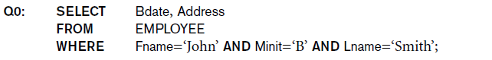
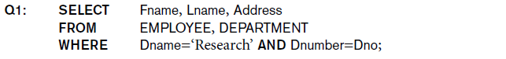
Basic Retrieval Queries (1 of 2)
(a)
Bdate | Address
1965-01-09 | 731Fondren, Houston, TX
(b)
Fname | Lname | Address
John | Smith | 731 Fondren, Houston, TX
Franklin | Wong | 638 Voss, Houston, TX
Ramesh | Narayan | 975 Fire Oak, Humble, TX
Joyce | English | 5631 Rice, Houston, TX
Query 0. Retrieve the birth date and address of the employee(s) whose name is ‘John B. Smith’.
Query 1. Retrieve the name and address of all employees who work for the ‘Research’ department.

Slide 31
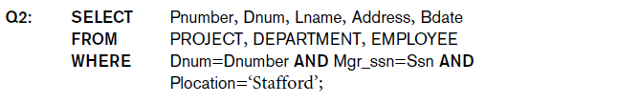
Basic Retrieval Queries (2 of 2)
(c)
Pnumber | Dnum | Lname | Address | Bdate
10 | 4 | Wallace | 291Berry, Bellaire, TX | 1941-06-20
30 | 4 | Wallace | 291Berry, Bellaire, TX | 1941-06-20
Query 2. For every project located in ‘Stafford’, list the project number, the controlling department number, and the department manager’s last name, address, and birth date.

Slide 32

Ambiguous Attribute Names
Same name can be used for two (or more) attributes in different relations
As long as the attributes are in different relations
Must qualify the attribute name with the relation name to prevent ambiguity

Slide 33

Aliasing, Renaming and Tuple Variables (1 of 2)
Aliases or tuple variables
Declare alternative relation names E and S to refer to the EMPLOYEE relation twice in a query:
Query 8. For each employee, retrieve the employee’s first and last name and the first and last name of his or her immediate supervisor.
Recommended practice to abbreviate names and to prefix same or similar attribute from multiple tables.

Slide 34
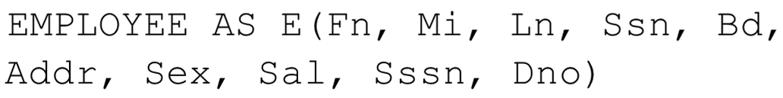
Aliasing, Renaming and Tuple Variables (2 of 2)
The attribute names can also be renamed
Note that the relation EMPLOYEE now has a variable name E which corresponds to a tuple variable
The “AS” may be dropped in most S Q L implementations

Slide 35
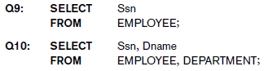
Unspecified WHERE Clause and Use of the Asterisk (1 of 2)
Missing WHERE clause
Indicates no condition on tuple selection
Effect is a CROSS PRODUCT
Result is all possible tuple combinations (or the Algebra operation of Cartesian Product– see Chapter 8) result
Queries 9 and 10. Select all EMPLOYEE S s n s (Q9) and all combinations of EMPLOYEE S s n and DEPARTMENT D name (Q10) in the database.

Slide 36
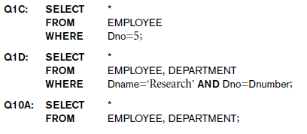
Unspecified WHERE Clause and Use of the Asterisk (2 of 2)
Specify an asterisk (*)
Retrieve all the attribute values of the selected tuples
The * can be prefixed by the relation name; e.g., EMPLOYEE *

Slide 37
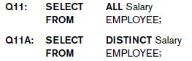
Tables as Sets in S Q L (1 of 2)
S Q L does not automatically eliminate duplicate tuples in query results
For aggregate operations (See sec 7.1.7) duplicates must be accounted for
Use the keyword DISTINCT in the SELECT clause
Only distinct tuples should remain in the result
Query 11. Retrieve the salary of every employee (Q11) and all distinct salary values (Q11A).

Slide 38
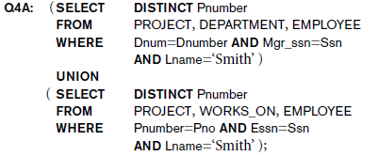
Tables as Sets in S Q L (2 of 2)
Set operations
UNION, EXCEPT (difference), INTERSECT
Corresponding multiset operations: UNION ALL, EXCEPT ALL, INTERSECT ALL)
Type compatibility is needed for these operations to be valid
Query 4. Make a list of all project numbers for projects that involve an employee whose last name is ‘Smith’, either as a worker or as a manager of the department that controls the project.

Slide 39
Substring Pattern Matching and Arithmetic Operators
LIKE comparison operator
Used for string pattern matching
% replaces an arbitrary number of zero or more characters
underscore (_) replaces a single character
Examples: WHERE Address LIKE ‘%Houston,TX%’;
WHERE S s n LIKE ‘_ _ 1_ _ 8901’;
BETWEEN comparison operator
E.g., in Q14 :
WHERE(Salary BETWEEN 30000 AND 40000) AND D n o = 5;

Slide 40

Arithmetic Operations
Standard arithmetic operators:
Addition (+), subtraction (–), multiplication (*), and division (/) may be included as a part of SELECT
Query 13. Show the resulting salaries if every employee working on the ‘ProductX’ project is given a 10 percent raise.

Slide 41
Ordering of Query Results
Use ORDER BY clause
Keyword D E S C to see result in a descending order of values
Keyword A S C to specify ascending order explicitly
Typically placed at the end of the query
ORDER BY D.D name D E S C, E.L name A S C, E.F name A S C

Slide 42
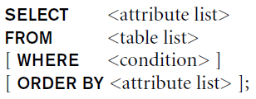
Basic S Q L Retrieval Query Block

Slide 43
INSERT, DELETE, and UPDATE Statements in S Q L
Three commands used to modify the database:
INSERT, DELETE, and UPDATE
INSERT typically inserts a tuple (row) in a relation (table)
UPDATE may update a number of tuples (rows) in a relation (table) that satisfy the condition
DELETE may also update a number of tuples (rows) in a relation (table) that satisfy the condition

Slide 44
INSERT
In its simplest form, it is used to add one or more tuples to a relation
Attribute values should be listed in the same order as the attributes were specified in the CREATE TABLE command
Constraints on data types are observed automatically
Any integrity constraints as a part of the D D L specification are enforced

Slide 45

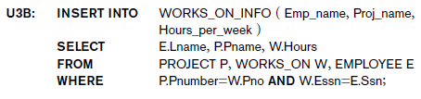
The INSERT Command
Specify the relation name and a list of values for the tuple. All values including nulls are supplied.
The variation below inserts multiple tuples where a new table is loaded values from the result of a query.

Slide 46
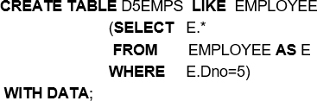
Bulk Loading of Tables
Another variation of INSERT is used for bulk-loading of several tuples into tables
A new table T NEW can be created with the same attributes as T and using LIKE and DATA in the syntax, it can be loaded with entire data.
EXAMPLE:

Slide 47
DELETE
Removes tuples from a relation
Includes a WHERE-clause to select the tuples to be deleted
Referential integrity should be enforced
Tuples are deleted from only one table at a time (unless CASCADE is specified on a referential integrity constraint)
A missing WHERE-clause specifies that all tuples in the relation are to be deleted; the table then becomes an empty table
The number of tuples deleted depends on the number of tuples in the relation that satisfy the WHERE-clause

Slide 48
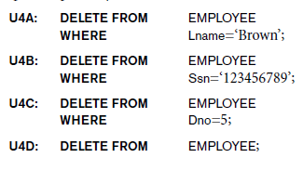
The DELETE Command
Removes tuples from a relation
Includes a WHERE clause to select the tuples to be deleted. The number of tuples deleted will vary.

Slide 49
UPDATE (1 of 3)
Used to modify attribute values of one or more selected tuples
A WHERE-clause selects the tuples to be modified
An additional SET-clause specifies the attributes to be modified and their new values
Each command modifies tuples in the same relation
Referential integrity specified as part of D D L specification is enforced

Slide 50

UPDATE (2 of 3)
Example: Change the location and controlling department number of project number 10 to ‘Bellaire’ and 5, respectively

Slide 51

UPDATE (3 of 3)
Example: Give all employees in the ‘Research’ department a 10% raise in salary.
In this request, the modified SALARY value depends on the original SALARY value in each tuple
The reference to the SALARY attribute on the right of = refers to the old SALARY value before modification
The reference to the SALARY attribute on the left of = refers to the new SALARY value after modification

Slide 52
Additional Features of S Q L (1 of 2)
Techniques for specifying complex retrieval queries (see Chapter 7)
Writing programs in various programming languages that include S Q L statements: Embedded and dynamic S Q L, S Q L/C L I (Call Level Interface) and its predecessor O D B C, S Q L/P S M (Persistent Stored Module) (See Chapter 10)
Set of commands for specifying physical database design parameters, file structures for relations, and access paths, e.g., CREATE INDEX

Slide 53
Additional Features of S Q L (2 of 2)
Transaction control commands (Chapter 20)
Specifying the granting and revoking of privileges to users (Chapter 30)
Constructs for creating triggers (Chapter 26)
Enhanced relational systems known as object-relational define relations as classes. Abstract data types (called User Defined Types- U D T s) are supported with CREATE TYPE
New technologies such as X M L (Chapter 13) and O L A P (Chapter 29) are added to versions of S Q L

Slide 54
Summary
S Q L
A Comprehensive language for relational database management
Data definition, queries, updates, constraint specification, and view definition
Covered:
Data definition commands for creating tables
Commands for constraint specification
Simple retrieval queries
Database update commands

Slide 55

Copyright

